Slide 1


Topic Modeling of Canadian Regulations
DS 8008 - NLP Project
Eisha Patel
Chaitra Hosmani

Slide 2

Overview
1
Introduction
2
Related Work
Methodology
Data Preparation ~ Building the LDA Model ~ Visualizing LDA Topics ~ Document Grouping ~ Time Evolution of Topics
3
4
Results
5
Conclusion

Slide 3
Overview
1
Introduction
2
Related Work
Methodology
Data Preparation ~ Building the LDA Model ~ Visualizing LDA Topics ~ Document Grouping ~ Time Evolution of Topics
3
4
Results
5
Conclusion

Slide 4

Introduction
It’s a challenge for the Legal Community to go thru thousands of Legal documents to find what they need.
How can we make this less painful?
Problem Statement:
How to simplify understanding of regulation documents?
How can we analyse the evolution of regulations over time?

Slide 5
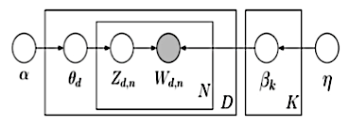
Introduction
Topic Modeling is a set of techniques that aim to discover and annotate large archives of documents with thematic information.
Unsupervised machine learning technique for which the validation of accuracy is mainly subjective
Latent Dirichlet Allocation (LDA) - a continuous multivariate probabilistic model
θ — A distribution of topics, one for each document
Z — k Topics for each document
β — distribution of words, one for each topic
D — All the data we have (i.e. corpus)
α — A parameter vector for each document (document — Topic distribution)
η — A parameter vector for each topic (topic — word distribution)

Slide 6
Overview
1
Introduction
2
Related Work
Methodology
Data Preparation ~ Building the LDA Model ~ Visualizing LDA Topics ~ Document Grouping ~ Time Evolution of Topics
3
4
Results
5
Conclusion

Slide 7
Related Work
A Survey of Topic Modeling in Text Mining ¹
Different methodologies for topic modelling methods : LSA, pLSA, LDA and Correlated Topic Model (CTM).
Topic Over Time (TOT), Dynamic Topic Models (DTM)
2. Automatic Evaluation of Topic Coherence ²
Coherence score evaluates the quality of a given topic, in terms of its coherence to a human
Intrinsic (UMass) measures to compare a word only to the preceding and succeeding words respectively, need ordered words
Extrinsic (UCI): every single word is paired with every other single word. Uses pointwise mutual information (PMI)
¹ https://thesai.org/Downloads/Volume6No1/Paper_21-A_Survey_of_Topic_Modeling_in_Text_Mining.pdf
² https://mimno.infosci.cornell.edu/info6150/readings/N10-1012.pdf

Slide 8
Overview
1
Introduction
2
Related Work
Methodology
Data Preparation ~ Building the LDA Model ~ Visualizing LDA Topics ~ Document Grouping ~ Time Evolution of Topics
3
4
Results
5
Conclusion

Slide 9
Methodology: Data Preparation
Dataset contents:
columns: [‘instrumentNumber','shorttitle','longtitle','modifiedyear', 'registrationyear',’consolidationyear','xrefxternal', ‘content']
rows: 2062
Extract the XML files using the code provided by Prof. Shariyar
Reduce Dataset to required columns only
Remove all rows with missing registration year
Convert content column to list of documents
Tokenize documents
Remove stopwords
Extract bigrams/trigrams
Lemmatization

Slide 10
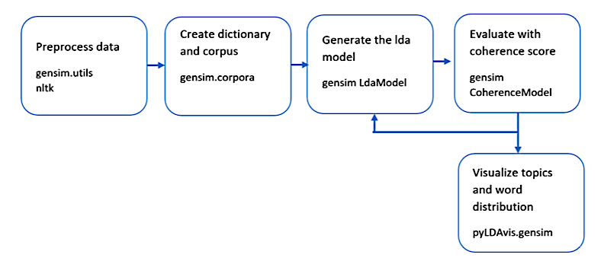
Methodology: Building the LDA Model

Slide 11
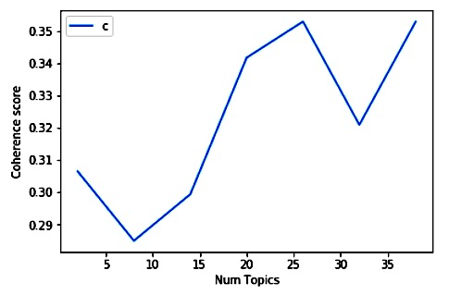
Methodology: Building the LDA Model
How many Topics are ideal?
Coherence score looks at the set of words generated in a topic and rates the interpretability of the topic
We need to maximize this score

Slide 12
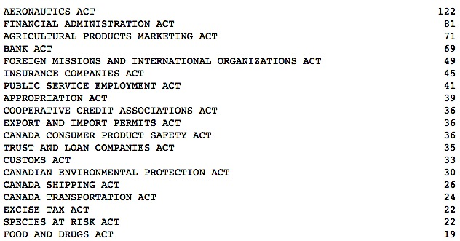
Methodology: Building the LDA Model
What can we expect our topics to look like?
Extract all unique Acts from the 'xrefxternal' using regular expression
List of top 19 Acts with frequency of occurrence

Slide 13
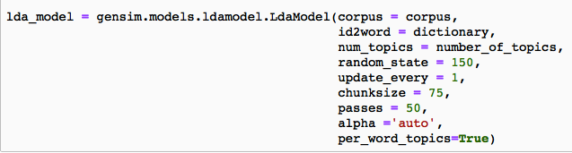
Methodology: Building the LDA Model
The Gensim LDA model take 2 inputs
1) Dictionary of words
2) Term-Document frequency matrix (ie. corpus)

Slide 14
Methodology: Building the LDA Model
Topic 7
free
tariff
good
item
custom
duty
import
January
sor
Canada
Topic 8
product
cannabis
originate
origin
manufacture
sale
container
display
exporter
package
Topic 14
service
public
group
period
employ
employee
employment
employer
cease
department
Topic 22
boundary
water
area
land
direction
activity
measure
zone
plan
northwest_terri
Topic 24
amount
pay
fee
payment
payable
interest
respect
rate
day
sor

Slide 15
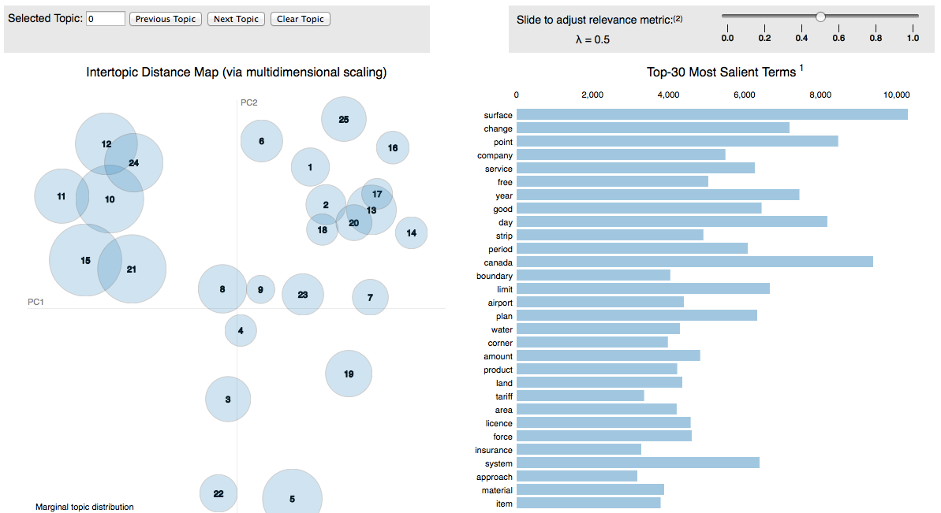
Methodology: Visualizing LDA Topics
file:///Users/eishapatel/Desktop/DS%20-%208008/DS%208008%20-%20project/vis25.html
pyLDAvis

Slide 16
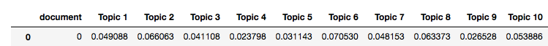
Methodology: Document Grouping
Each document can be described by a list of topics and correlation values that relates the topics to the document.
The list of topics and correlation is unique among documents and can also be considered the signature of that document.
Since one document can be highly correlated to multiple topics, we can create soft clusters of documents
Example: document 1 and it’s probabilities
. . . 25

Slide 17
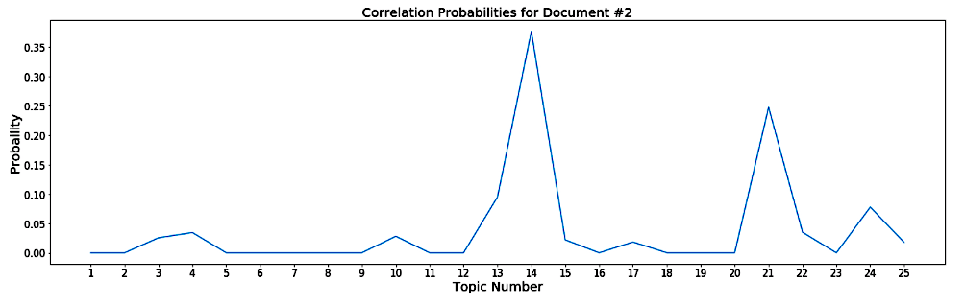
Methodology: Document Grouping
'
PUBLIC SERVICE LABOUR RELATIONS ACT’
['public', 'service', 'labour_relation', 'designate', 'staff', 'public', 'fund', 'canadian', 'force', 'separate', 'employer', 'purpose', 'excellency', 'governor', 'general', 'council', 'recommendation', 'minister', 'national_defence', 'pursuant', 'public', 'service', 'staff_relation', 'designate', 'staff', 'public', 'fund', 'canadian', 'force', 'separate', 'employer', 'purpose', 'public', 'service', 'staff_relation', 'provision', 'reference', 'context_requir', 'reference', 'public', 'service', 'labour_relation', 'provision', 'define', 'statutory_instrument', 'parliament', 'provision', 'refer', 'read', 'reference', 'federal', 'public', 'sector_labour_relation']

Slide 18
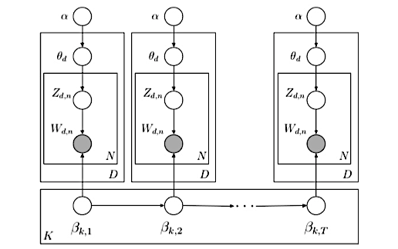
Methodology: Time Evolution of Topics
Dynamic Topic Modelling
Captures the evolution of topics in a sequentially organized corpus of documents
Documents are grouped by time slice (e.g.: years): documents order matter
Exploration of a large document collection in new way

Slide 19
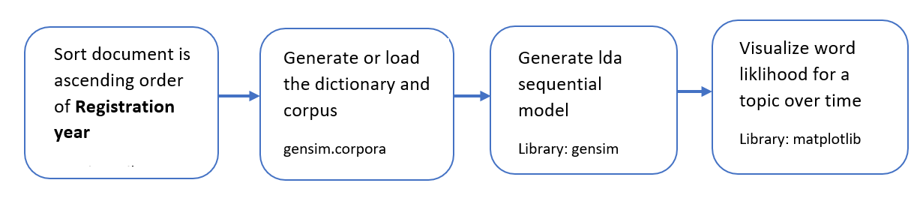
Methodology: Time Evolution of Topics
Dynamic Topic Modelling Approach

Slide 20
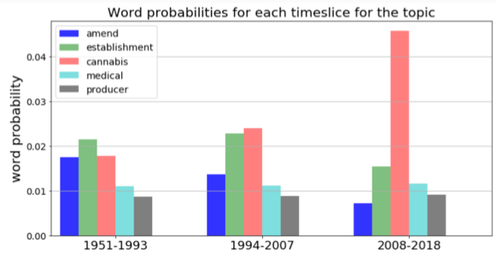
Experiment 1: Evolution with 3 time slices
Topic A
time
security
cannabis
establishment
amend
medical
producer
registration
blood
distribute
Food and Drugs Act Controlled Drugs and Substances Act Cannabis Act/regulations,
Cannabis Act/regulations, Tobacco and Vaping Products Act/regulations

Slide 21
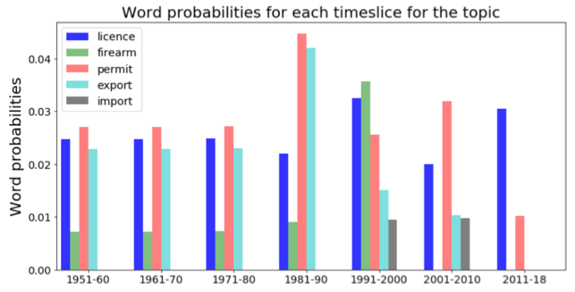
Experiment 2: Evolution with 10 years window
Topic B
firearm
licence
request
issue
permit
chemical
quantity
registration
import
export
Firearms Act and Regulations
Chemical Weapons Convention Implementation Act

Slide 22
Overview
1
Introduction
2
Related Work
Methodology
Data Preparation ~ Building the LDA Model ~ Visualizing LDA Topics ~ Document Grouping ~ Time Evolution of Topics
3
4
Results
5
Conclusion

Slide 23
Results
Coherence Scores can be used to determine how many topics to create
Topics generated reflect the ‘Acts’ in the dataset
pyLDAvis shows the clusters of topics
The correlation between a document and topic is measured by correlation probability, but we can’t group documents by these values unless they are significantly large
Correlation probabilities can be used to ‘tag’ documents with possible topics
Able to analyze evolution of some topics over time
It did not capture new topic which might have emerged in between entire time period

Slide 24
Overview
1
Introduction
2
Related Work
Methodology
Data Preparation ~ Building the LDA Model ~ Visualizing LDA Topics ~ Document Grouping ~ Time Evolution of Topics
3
4
Results
5
Conclusion

Slide 25
Conclusion
Fine-Tuning the Corpus:
Remove words that occur in too many topics and do not contribute to the semantics of a topic
This will improve the correlation between a document and its relevant topics
It will also improve DTM analysis
Implement other visualization techniques for DTM to observe trends

Slide 26
References
Legal Documents Clustering and Summarization using Hierarchical Latent Dirichlet Allocation - Ravi Venkatesh - IAES International Journal of Artificial Intelligence (IJ-AI) - 2013
Sentiment-topic modeling in text mining - Chenghua Lin-Ebuka Ibeke-Adam Wyner-Frank Guerin - Wiley Interdisciplinary Reviews: Data Mining and Knowledge Discovery - 2015
Latent Dirichlet Allocation - David M. Blei, Andrew Y. Ng and Michael I. Jordan. University of California, Berkeley - 2003
A heuristic approach to determine an appropriate number of topics in topic modelling - Weizhong Zhao-James Chen-Roger Perkins-Zhichao Liu-Weigong Ge-Yijun Ding-Wen Zou - BMC Bioinformatics - 2015
Topic Modeling in Python with Gensim - https://www.machinelearningplus.com/nlp/topic-modeling-gensim-python/
Topic Modelling For Finding Similar Contracts - https://medium.com/@dudsdu/topic-modelling-for-finding-similar-contracts-df00b3aea8b2

Slide 27

Thank You

